Slide 1
Two Dimensional Array in C
Md. Alamgir Hossain
Senior Lecturer,
Dept. of CSE, Prime University
Mail: alamgir.cse14.just@gmail.com

Slide 2

Two Dimensional Array in C
The two-dimensional array can be defined as an array of arrays.
The 2D array is organized as matrices which can be represented as the collection of rows and columns.
However, 2D arrays are created to implement a relational database lookalike data structure.
It provides ease of holding the bulk of data at once which can be passed to any number of functions wherever required.

Slide 3
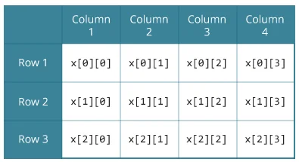
Two Dimensional Array in C
float x[3][4]; Here, x is a two-dimensional (2d) array. The array can hold 12 elements. You can think the array as a table with 3 rows and each row has 4 columns.

Slide 4

Declaration and Initialization of a 2d array
data_type array_name[rows][columns];
Different ways to initialize two-dimensional array
int c[2][3] = {{1, 3, 0}, {-1, 5, 9}};
int c[][3] = {{1, 3, 0}, {-1, 5, 9}};
int c[2][3] = {1, 3, 0, -1, 5, 9};
int arr[4][3]={{1, 2, 3}, {2, 3, 4}, {3, 4, 5}, {4, 5, 6}};

Slide 5
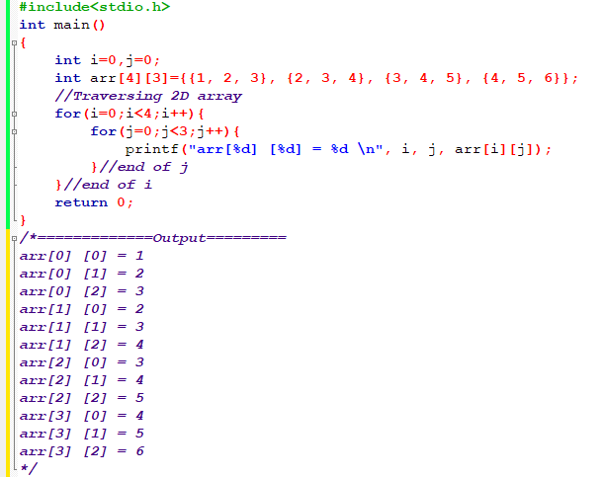
Traversing 2D Array

Slide 6
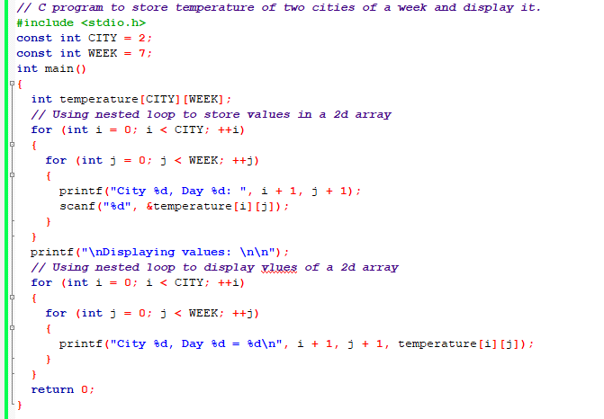
Two-dimensional array to store and print values

Slide 7
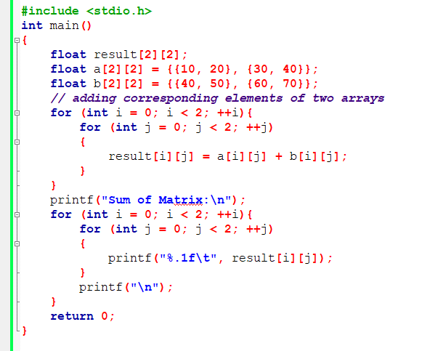
C program to find the sum of two matrices of order 2*2

Slide 8
Homework
Write a C program to multiply two matrices.

Slide 9
Thank You

